Slide 1

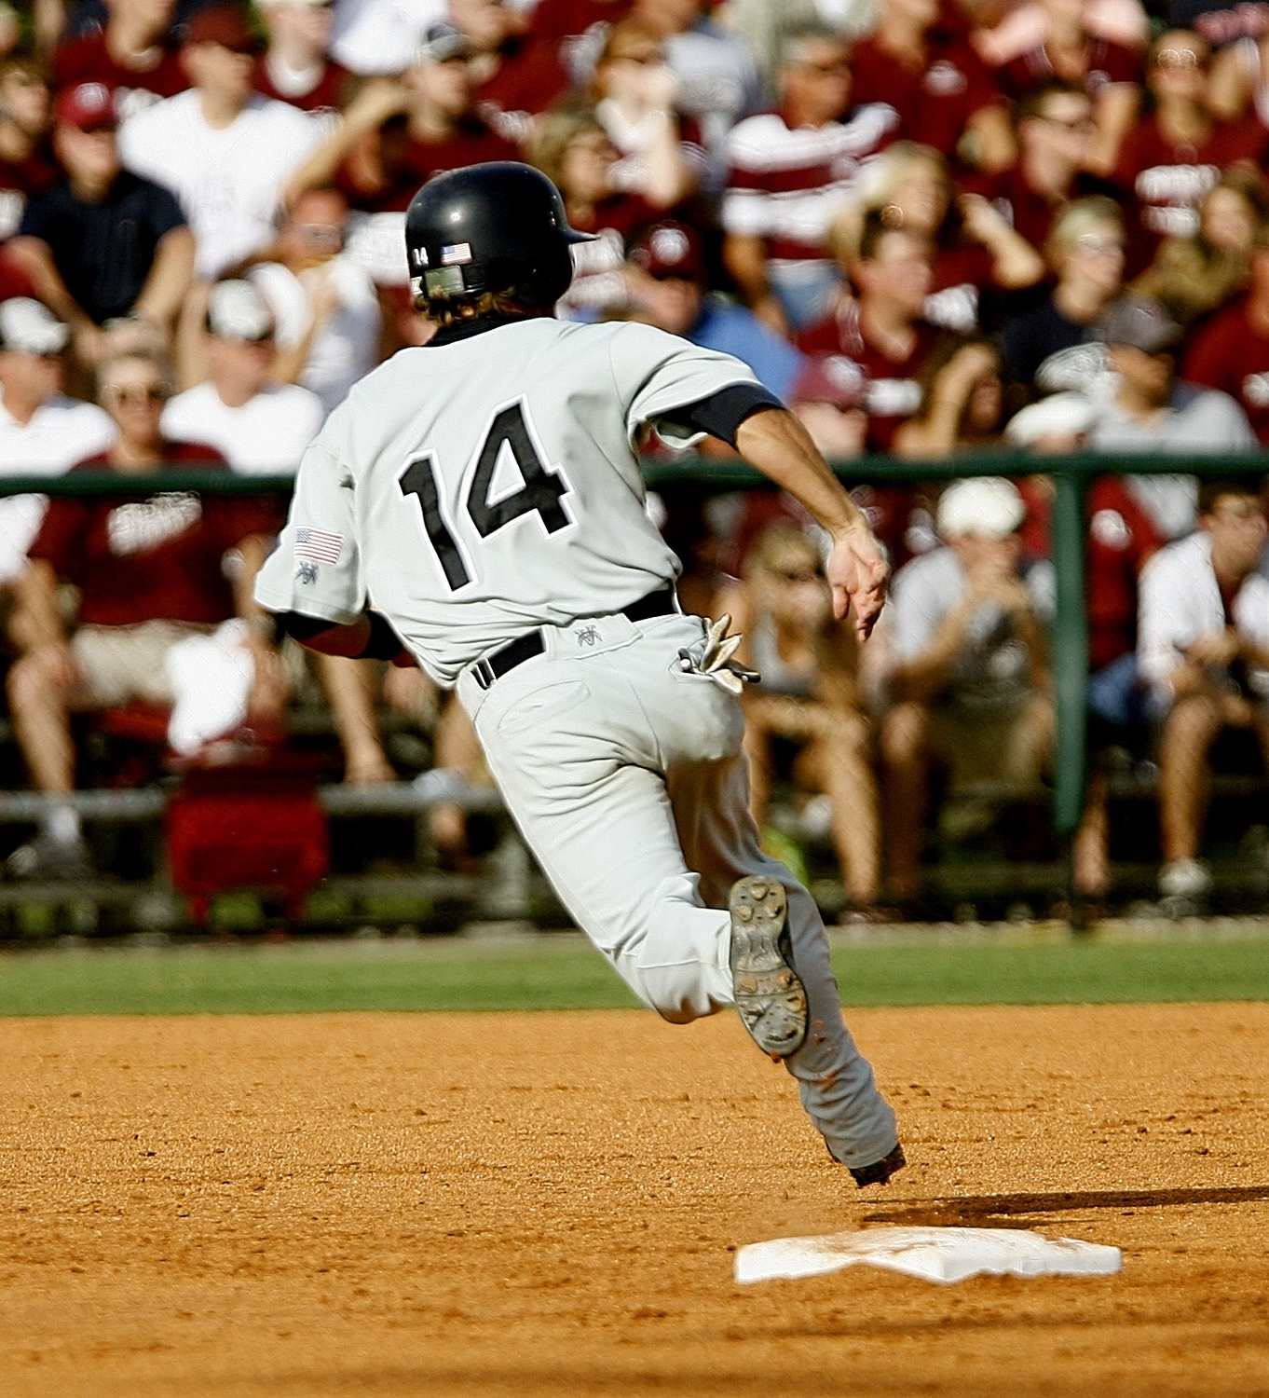
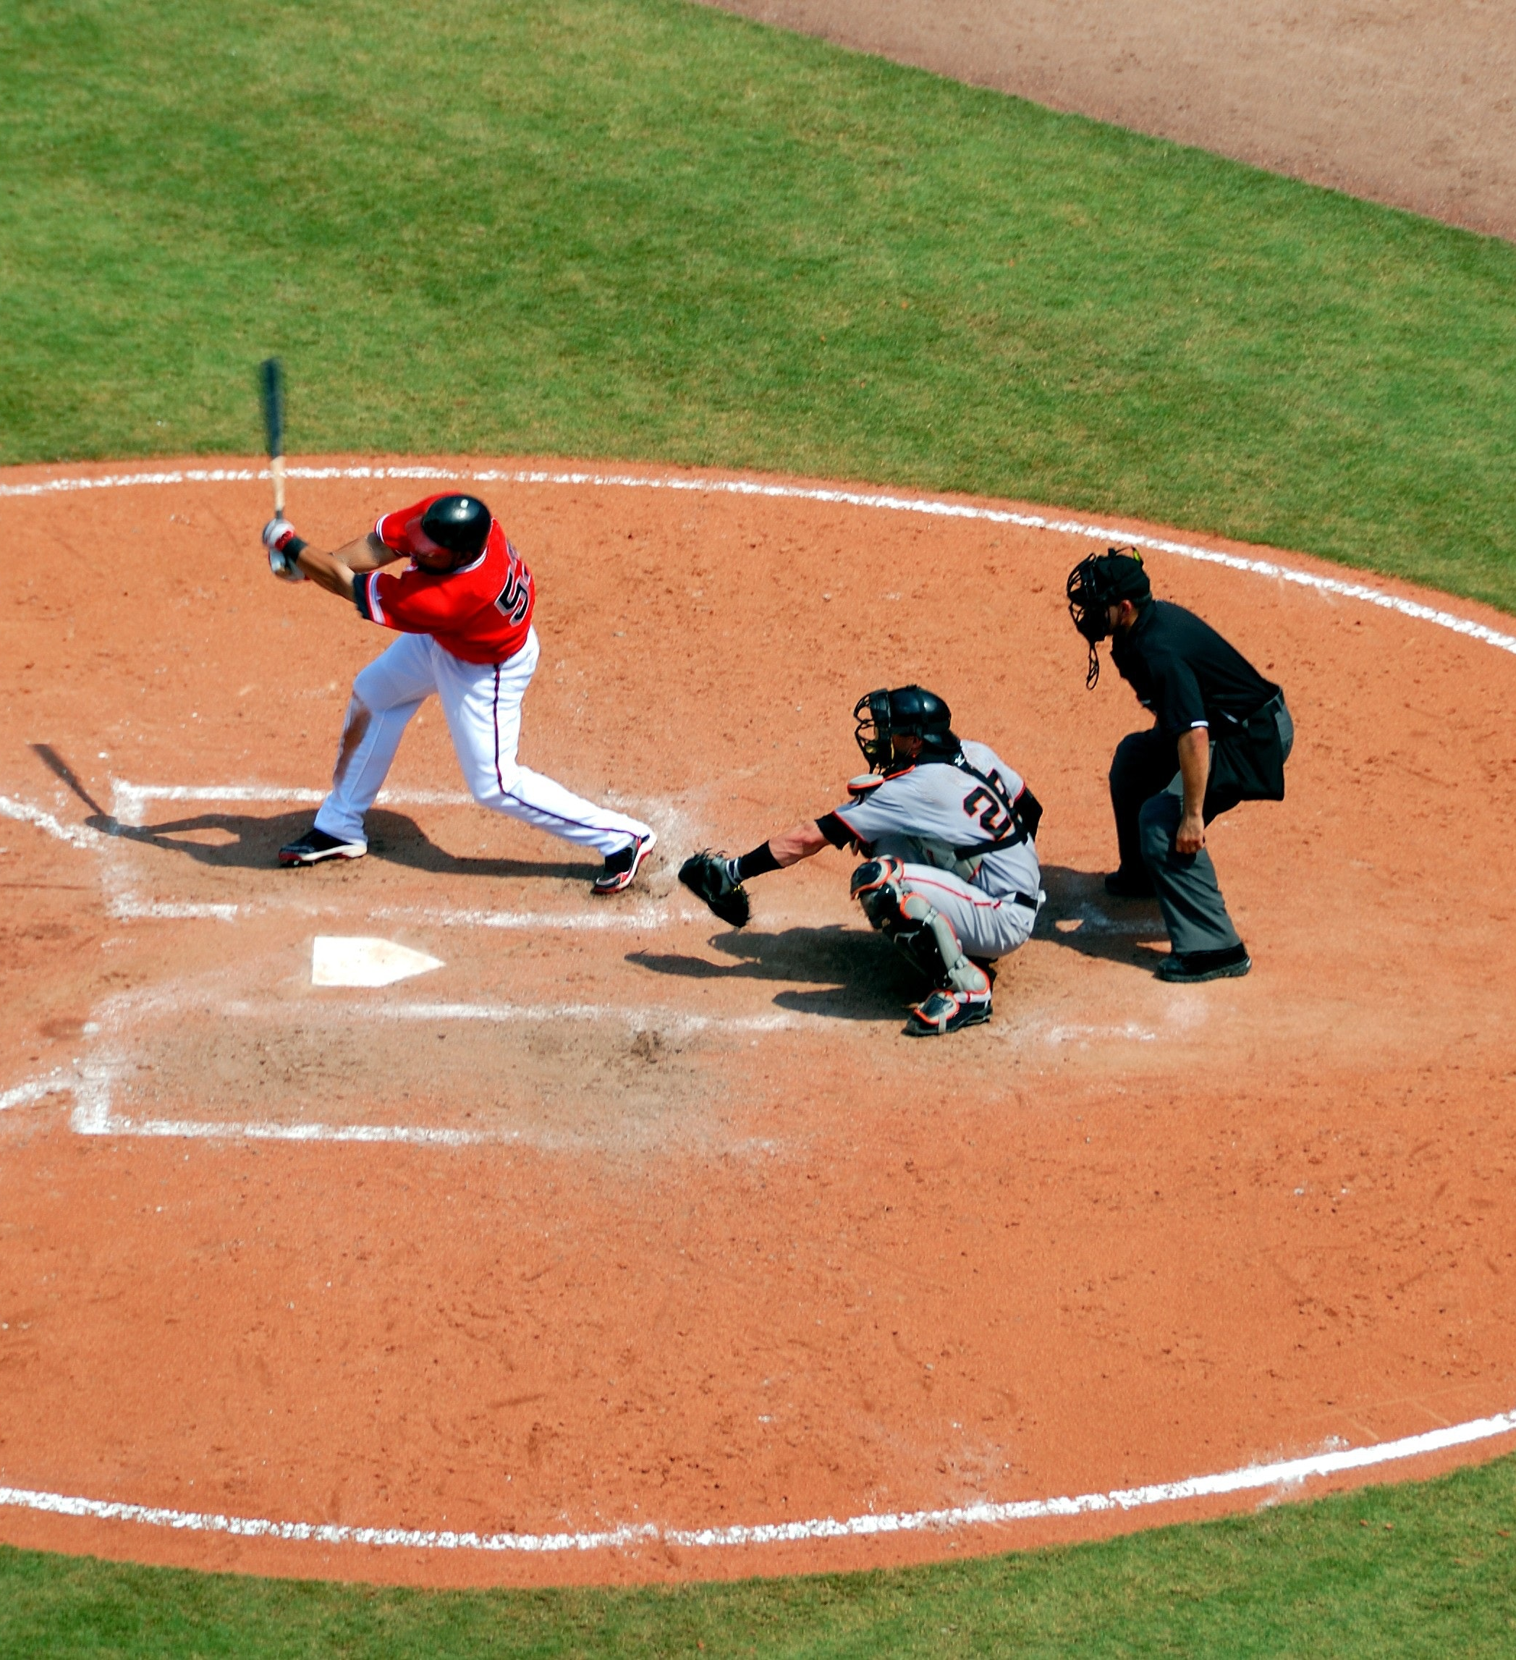
The Lahman Baseball Database

Slide 2
The Lahman Baseball Database contains:
1871 – 2016 years
Major League Baseball
Pitching, hitting, fielding stats
American and National Leagues
The four other “major” leagues: American Association, Union Association, Players League, Federal League
and the National Association of 1871-1875.
Notes:
This database contains pitching, hitting, and fielding statistics for Major League Baseball from 1871 through 2016. It includes data from the two current leagues (American and National), the four other "major" Leagues.

Slide 3
Data Tables
MASTER: player names, DOB, and biographical info
Batting: batting statistics
Pitching: pitching statistics
Fielding: fielding statistics
Notes:
There are 4 main tables there: master, batting, pitching and fielding.

Slide 4
Supplemented by:
AllStarFull - All-Star appearances
HallofFame - Hall of Fame voting data
Managers - managerial statistics
Teams - yearly stats and standings
BattingPost - post-season batting statistics
PitchingPost - post-season pitching statistics
TeamFranchises - franchise information
FieldingOF - outfield position data
FieldingPost- post-season fielding data
FieldingOFsplit - LF/CF/RF splits
ManagersHalf - split season data for managers
TeamsHalf - split season data for teams
Salaries - player salary data
SeriesPost - post-season series information
AwardsManagers - awards won by managers
AwardsPlayers - awards won by players
AwardsShareManagers - award voting for manager awards
AwardsSharePlayers - award voting for player awards
Appearances - details on the positions a player appeared at
Schools - list of colleges that players attended
CollegePlaying - list of players and the colleges they attended
Parks - list of major league ballparls
HomeGames - Number of homegames played by each team in each ballpark
Notes:
The database is supplemented by the following tables you can see on this slide.

Slide 5
Who is the shortest player in the Database?
Notes:
I decided it would be interesting to explore the shortest player in the database. So, who is the shortest player in the database?

Slide 6
Eddie Gaedel

Slide 7
How many games did he play in?
Notes:
The data analysis showed he played in 52 games

Slide 8
52

Slide 9

What is the name of the team for which he played?
St. Louis Browns
Notes:
The name of the team he played for is St. Louis Browns

Slide 10
How short was Eddie?

Slide 11
Eddie was:
43 in
or 3 ft 7 in
or 109 cm
or 1 m 09 cm
65 lbs (29 kg)
Notes:
Eddie was 43 inches and weighed 65 pounds.

Slide 12
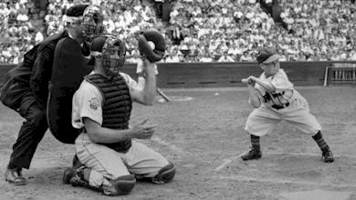
Batting is the act of facing the opposing pitcher and trying to produce offense for one's team. A batter or hitter is a person whose turn it is to face the pitcher. Plate appearance: a player is credited with a plate appearance each time he completes a turn batting.
Gaedel batting in August 1951, in his only plate appearance in baseball
Notes:
In this picture you can see Eddie batting in August 1951 in his only plate appearance in baseball.

Slide 13
Does the size matter?
Yes.
the taller the athletes
the more force
the faster a ball flies.
Height = speed
Notes:
As it turns out, height matters; the taller the athletes are, the more force they have to throw themselves forward and make a ball fly faster.
For pitchers, in particular, height means speed.

Slide 14
Is there a height requirement for baseball?
No, there is no written height minimum
However…
the commissioner has the ability to void any contract on any baseball team
Notes:
No, there is no written height minimum for Major League Baseball. However, the commissioner has the ability to void any contract on any baseball team, which is what happened to Eddie Gaedel when he was inserted as a pinch hitter during a St. Louis Browns game after being signed by Bill Veeck, Brown's GM.

Slide 15
Death
On June 18, 1961, the unemployed Gaedel, who had just turned 36 was found bruised up and dead in his bed by his mother
A coroner's inquest determined that he also had suffered a heart attack
Notes:
On June 18, 1961, the unemployed Gaedel, who had just turned 36, was at a bowling alley in Chicago, his birthplace and hometown. Gaedel was followed home and beaten. His mother discovered him lying dead in his bed. He had bruises on his knees and on the left side of his face. A coroner's inquest determined that he also had suffered a heart attack.

Slide 16
Legacy
Gaedel is one of only five Major League players who drew a walk in their only plate appearance and never played the field
Gaedel's one-day career has been the subject of programs on ESPN and MLB Network
Due to its scarcity, Gaedel's autograph now sells for more than Babe Ruth's

Slide 17
Questions?

